Slide 1
Chapter 11
1800-1812:
The “Jeffersonian” Era

Slide 2
The “Revolution of 1800”
Jefferson wins, Burr becomes VP
Peaceful transfer of power among parties
12th Amendment
Jefferson keeps virtually all of Hamilton’s policies in place (not excise tax)
“We are all Republicans, we are all Federalists.”

Slide 3
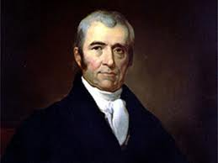
Emerging Judicial Branch
Judiciary Act of 1801
Created 16 new judgeships and other offices
“Midnight Judges”
Last minute appointments by Adams prior to leaving office
JOHN MARSHALL (KNOW HIM AT ALL COSTS)
Served 34 years
INCREASED THE POWER OF THE FEDERAL GOVERNMENT

Slide 4
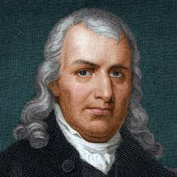
More Judicial Branch
Marbury vs. Madison (1803)
Marbury sues Secretary of State Madison
Result: Part of Judiciary Act ruled unconstitutional
***SIGNIFICANCE***
Judicial Branch is the sole interpreter of the constitution
Sets the precedent that the Supreme Court can declare laws unconstitutional
Samuel Chase:
Impeached by Republicans – due to personality
Found not guilty in the Senate
Significance: No real serious attempt has been made to reshape S.C. by impeachment

Slide 5
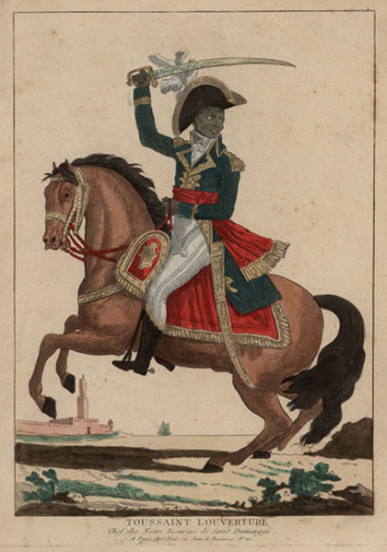
Louisiana Purchase
French control of New Orleans and Mississippi
Influenced by slave revolt in Santo Domingo (Toussaint L’Ouverture)
Napoleon Bonaparte decides to focus on Europe

Slide 6
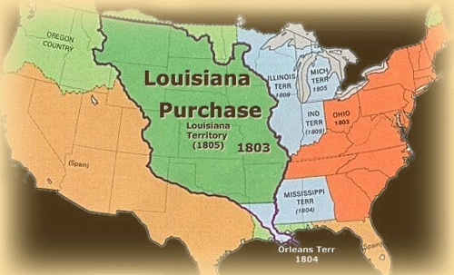
The Louisiana Purchase – contd.
Jefferson tries to buy New Orleans from the French for $10 million.
Livingston and Monroe (5th president) are offered all of Louisiana for $15 million!
Plus cancellation of French debts!!
Significance: Jefferson thought this was necessary to the country, but felt it was unconstitutional
Role reversal of strict vs. loose interpretation
US doubled in size!
Adds ~830K square miles

Slide 7
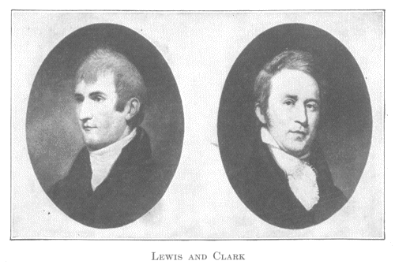
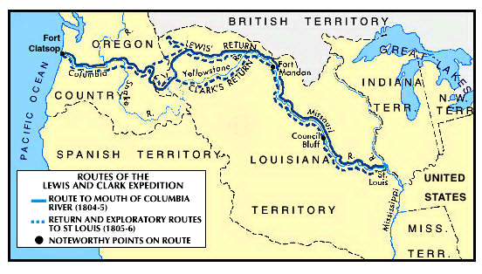
Lewis and Clark
1803
1806
Jefferson commissions Meriwether Lewis and William Clark to explore Louisiana Territory and beyond to the Pacific Coast
Role of Sacajawea
Their expedition (1803-1806) brings back wealth of data about the country and its resources

Slide 8
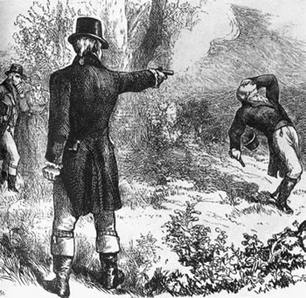
Aaron Burr
Burr plotted a secession of New England
Burr challenges Hamilton to a duel and kills him
His political career is over, tries to separate western part of US from east
Arrested and tried for treason.
Found not guilty
Flees to Europe and urges an alliance between France and England against US

Slide 9
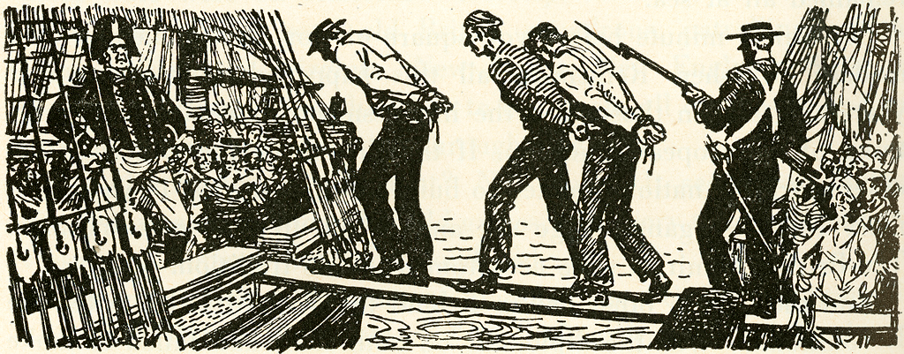
A Precarious Neutrality
America is caught between Britain and France
France has upper-hand on land
England has upper-hand on sea
Berlin Decree (1806): France would confiscate ships trading with Britain
Orders in Council (1806): Britain’s response to France, forced ships trading with France to stop in Britain first to be loaded with goods
IMPRESSMENT:
Forcible enlistment of American merchants and sailors into the British navy
Chesapeake Incident:
British warship fires on American ship, kills 3, injures 18. Angers Americans greatly

Slide 10
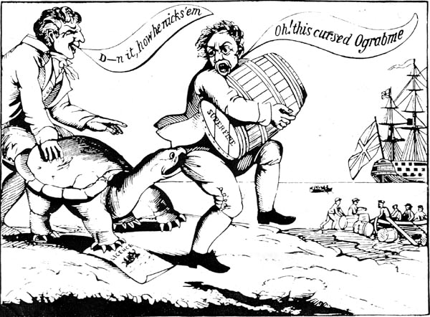
The Hated Embargo
Embargo Act of 1807:
Forbade export of ALL goods from US, no matter the destination
Intent was to make France and Britain respect America’s rights
The plan backfired horrifically
Economy of US takes a huge hit
New England was hurt the most (Federalists are angry)
Act revoked in 1809

Slide 11
Non-Intercourse Act:
Reopened trade with all nations of the world, except Britain and France
US economy is still hurting, needs those two large countries to trade with
Positives of embargos?
Beginnings of the Industrial Revolution are born
Factories begin to pop up in New England
Jefferson, who believed agriculture should be the main industry, helped spark industry (supported by Federalist Party)

Slide 12
Macon’s Bill #2
Purpose: to entice Britain or France to repeal shipping restrictions
U.S. would maintain its embargo against the nation that didn't sign on
Leads to US embargo against Britain, helps fuel the War of 1812

Slide 13
Why war with Britain and Not France?
1. War Hawks pushed Madison toward war
2. Visibility of British impressments and arming of Amerindians.
3. Chesapeake-Leopard Affair
4. Lure of conquering British Canada: timber, fishing, fur trade.
5. Madison poses question: Will a republic, a nation of “free people” fight to defend itself?

